Slide 1
Structures
Dr. Jacob Moore
Associate Professor of Engineering
Penn State Mont Alto

Slide 2
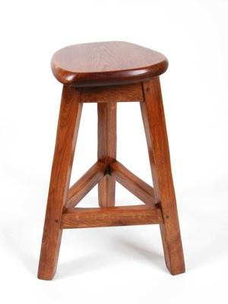
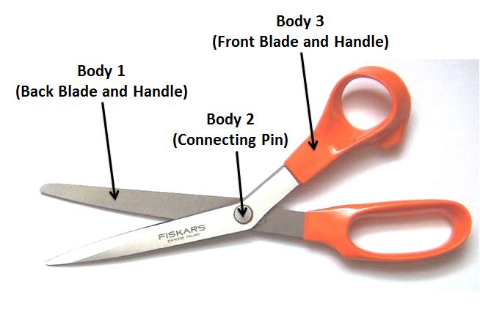
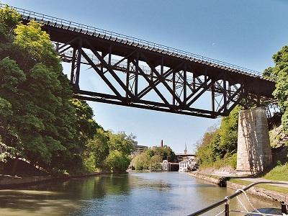
What is a Structure?
A structure is any collection of connected bodies

Slide 3
Types of Structures
Truss – Rigid assembly made entirely of two-force members.
Frame – Rigid assembly containing at least one member that is not a two-force member.
Machine – Non-rigid assembly containing at least one member that is not a two-force member.

Slide 4
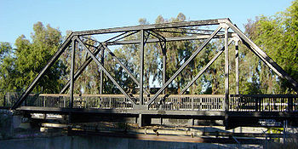
Trusses
A truss is a type of engineering structure where all the members in the structure are two force members.

Slide 5
Frames and Machines
A frame or a machine is a structure that has at least one member that is not a two-force member.
A frame is rigid
A machine is not rigid
Because we can’t assume that each member is a two-force member we can’t use the method of joints or method of sections.
Though it is still useful to identify the two-force members that are present for analysis.

Slide 6
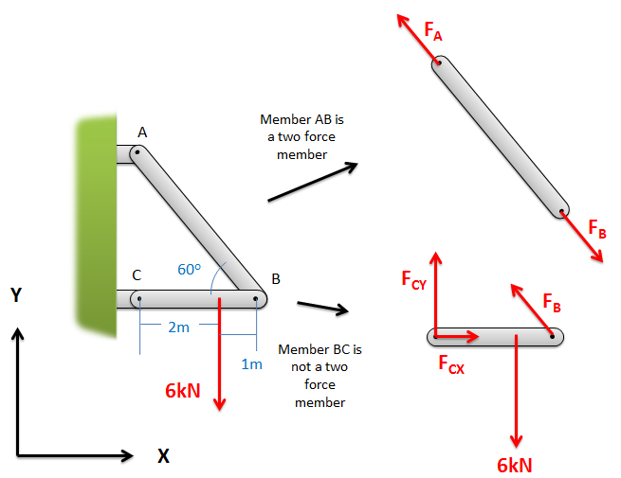
Analyzing Structures
As with everything in statics, the structure is assumed to be in equilibrium.
Because the structure is in equilibrium, each member (part of the structure) is also in equilibrium.
We analyze structures by breaking them down into parts and then performing static analysis on the pieces.

Slide 7
Important Factors for Structure Analysis
When making the jump from analyzing a single body to analyzing a collection of bodies, the two most important factors are...
The application of Newton’s Third Law.
The identification of Two Force Members.

Slide 8
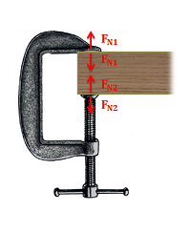
Newton’s Third Law
Newton’s Third states that “for every action (force) there is an equal and opposite reaction (other force)”.
In a structure, this means that whenever two bodies are connected, the force that body A exerts on body B will be equal and opposite to the force that body B exerts on Body A.

Slide 9
Newton’s Third Law
Though you analyze each body separately, Third Law pairs of forces will exist wherever two separate members in the structure are connected to one another.
These pairs will be equal in magnitude but opposite in direction.
This reduces the number of unknowns you will need to solve for.

Slide 10
Two Force Members
The next important factor is to look for two-force members.
A two-force member is a body that has forces (and no moments) exerted at only two points.

Slide 11
Two Force Members
A two-force member will have two equal, opposite, and collinear forces acting on it.
This is a result of Newton’s Second Law
This will also reduce the number of unknowns you will need to solve for.

Slide 12
Methods for Analyzing Structures
Identify the type of Structure you have
Trusses
Method of Joints
Method of Sections
Hybrid of Joints and Sections
Frames and Machines
Analysis of Frames and Machines
Relies heavily on Newton’s Third Law
Still important to identify two force members

Slide 13
Thanks for Watching
See other engineering mechanics videos and access the full tool at…

